Slide 1
Category review: Chips
June 2020
Retail Analytics
Brand note: If client logo is not required, use alternate title page layout right click slide thumbnail > Layout > Title

Slide 2
Notes:
To view Privacy video explaining how important data privacy is to Quantium, please click here: https://www.youtube.com/watch?v=Zq1QDAkoRzU
or here Q:\Company Reference\Brand & Design\Brand videos\Q Privacy.mp4
At Quantium, we believe that data is the behavioural footprint of humanity and that it has to be treated with the utmost care and responsibility.
Histories, attitudes, indeed lives are stored within it in ways that aren’t always apparent – and that’s what makes its potential so powerful.
To work with it responsibly, sensitively, we set ourselves the highest data privacy protection and governance standards.
We have spent 17 years perfecting privacy-by-design and secure-by-design principles. Central to this is not holding any personally identifiable information about people –
we neither receive it, and put the necessary protections in place to be unable to decipher it.
Every aspect of handling data is safeguarded: from its de-identification, to its encryption – data security is paramount and of the highest grade.
We pride ourselves on gaining the trust of iconic organisations around the world through years of securely working with their data,
and in turn the trust that builds with their stakeholders.

Slide 3
Executive summary
01
Task 1 Findings
Products less than 200 grams tend to perform better in terms of sales
Large drop-off in sales during February of 2019 before reaching a yearly high in March
Top brand is Kettle, followed by Doritos and Smiths
Older customers account for over half our sales
Mainstream customers make up nearly 39% of total sales
02
Task 2 Findings
Trial store 77 outperformed its control store (41). Store 77 saw an increase in sales during March while store 41 had a decrease in sales
Trial store 88 and control store 201 were very similar, however store 88 saw slightly greater sales figures over the 3-month period
Trial store 86 and control store 231 took identical paths, but store 231 outperformed store 88 in sales

Slide 4
01
Category

Slide 5
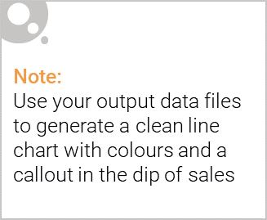
Overview:
We have discovered that products are very popular among the older population (older singles/couples, retirees, older families). The best-selling pack by size is 175 grams, with everything below performing well also. Our best-selling brand by far is Kettle, reaching nearly $400k in sales over the past year. Sales increase significantly around the end of Q4 before dropping off into the next year.
Recommendations:
Continue to target the older population, as they account for a large portion of our sales. If we wanted to attract the younger population, consider using social media marketing methods. Focus more on top brands and consider cutting out brands like Burger and French. Prepare for an increase in orders near the end of the year.

Slide 6
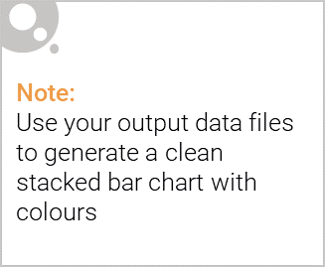
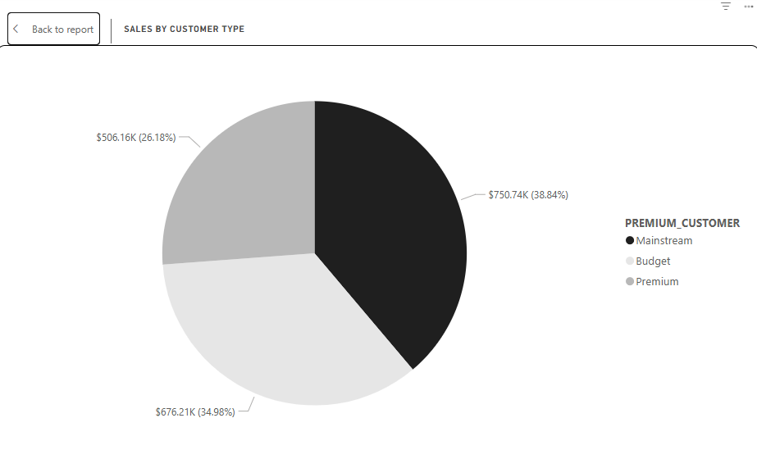
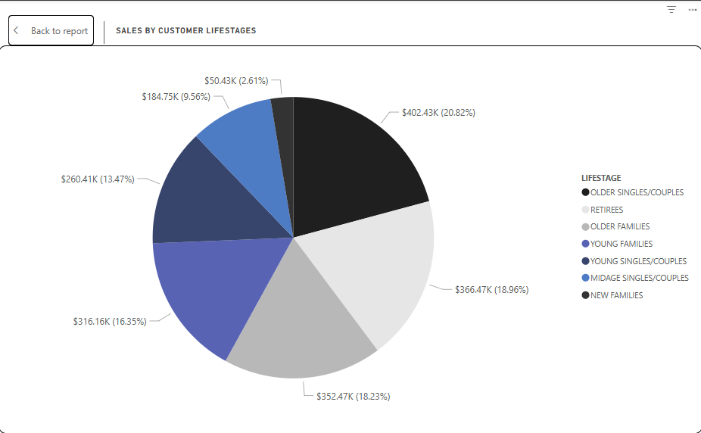
Editable (delete this)
Sales of customers by affluence and life stage

Slide 7
02
Trial store performance

Slide 8
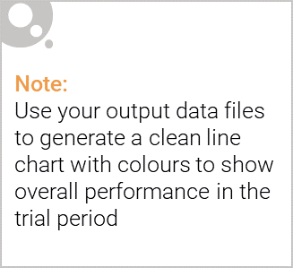
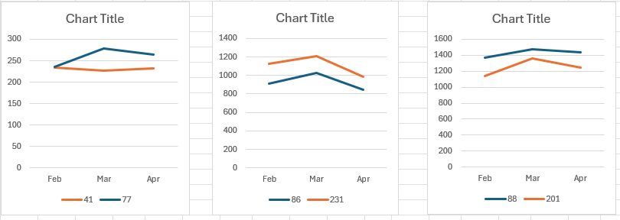
Control Stores vs. Trial Stores
As mentioned previously, trial stores included store 77, 86, and 88. Stores 41, 201, and 231 were chosen to be the control stores as they were closely correlated to the trial stores with sufficient sales volume.
Two trial runs outperformed
the control stores. The most
significant difference was
between 77 and 41.

Slide 9
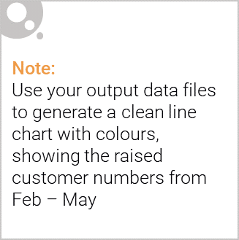
From our findings, trial store 77 had the biggest positive difference between the rest of the trial stores. Implementing the changes made to trial store 77 into the others is something that should be considered. Trial store 86 performed slightly worse than its control variant, but results were not significantly different. Similarly, results were not significantly different between trial store 88 and its control variant, but store 88 slightly outperformed its control variant. If any changes are to be made to the stores, it should be the changes made to store 77.

